Slide 1


Baseball IV
Produced by Dr. Mario | UNC STOR 390

Slide 2
Monte Carlo Simulation
Recall Evaluation of Hitter Effectiveness
Runs Created
Linear Weights
Both Based on Team Data
Scaled Player Information for Prediction
Problem: Player Hits HR 50% of Time
54 RC/G Estimated by Formula (Bill James)
36.8 RC/G Estimated by Linear Weights
Definition of Monte Carlo Simulation
Developing a Computer Model to Repeatedly Play Out an Uncertain Situation
Used Across All Industries
Term Coined by Polish Physicist Stanislaw Ulam
Simple Simulation Shows Previously Discussed Player = 27 RC/G

Slide 3
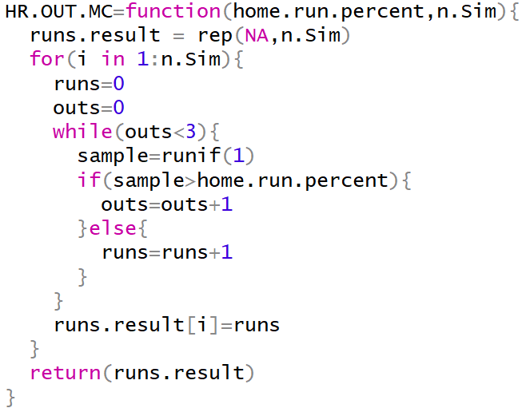
Monte Carlo Simulation
Monte Carlo Simulation in R
Theoretical Player Either Hits a Home Run or Gets an Out

Slide 4

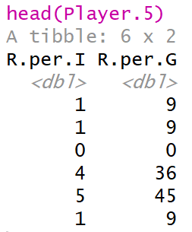
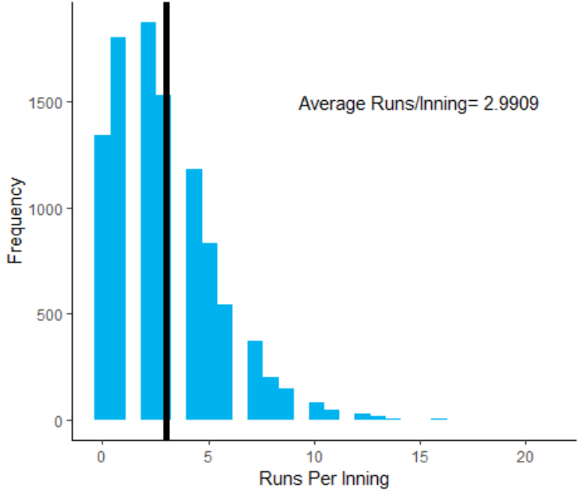

Monte Carlo Simulation
Monte Carlo Simulation in R
Suppose Player Hits Home Run 50% of the Time

Slide 5

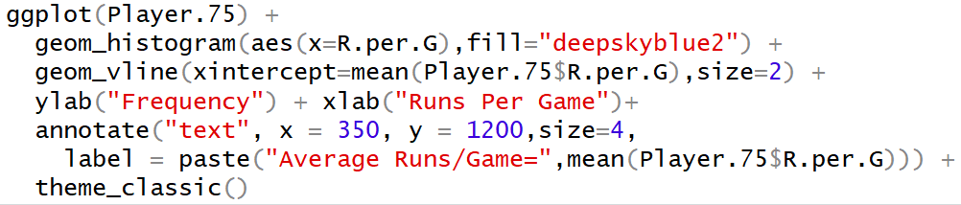
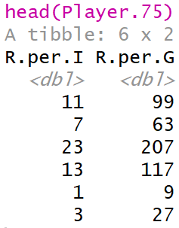
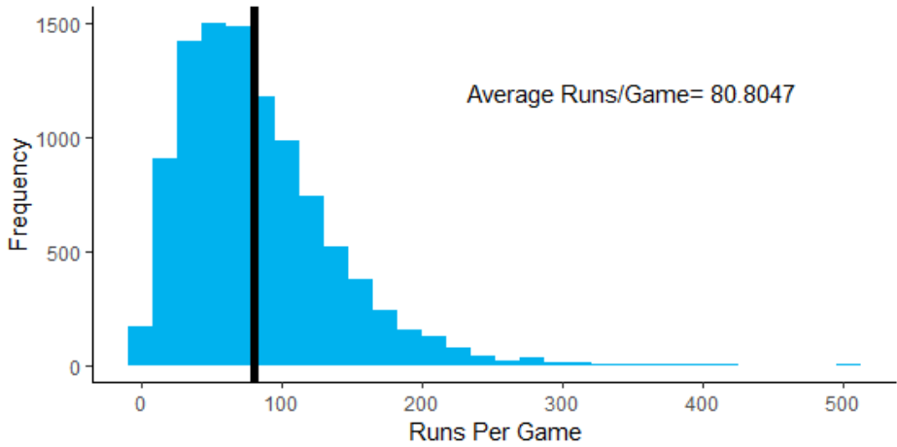
Monte Carlo Simulation
Monte Carlo Simulation in R
Suppose Player Hits Home Run 75% of the Time

Slide 6
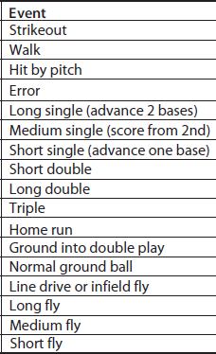
Monte Carlo Simulation
Simulating Runs from Team Full of Trouts
Possible Plate Appearances Events
Long List of Assumptions
Errors Advance All Base Runners 1 Base
Long Single Advances Each Runner 2 Bases
Short Single Advances All Runners 1 Base
Short Double Advances Each Runner 2 Bases
Long Double Scores a Runner from First
Etc.
Assign Probabilities According to Relative Frequencies of Player
Program for Simulation

Slide 7
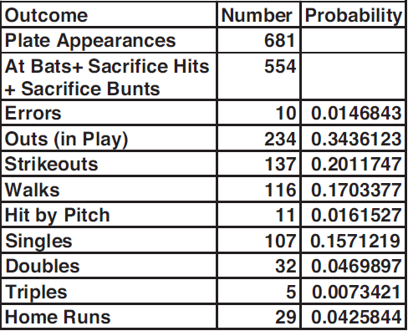
Monte Carlo Simulation
Simulating Runs from Team Full of Trouts
Probabilities Based on Trout 2016 Statistics

Slide 8

Monte Carlo Simulation
Simulating Runs from Team Full of Trouts
Probabilities of Special Cases
30% of Singles are Long Singles
50% of Singles are Medium Singles
20% of Singles are Short Singles
53.8% of Outs in Play are Ground Balls
15.3% of Outs in Play are Infield Flies
30.9% of Outs in Play are Fly Balls
Etc.
Result of Simulation = Within 1% of True Actual Runs Per Game
Specific to Trout
Random Number < 0.157 = Single
0.157 < Random Number < (0.157+0.047) = Double
Goal of Simulation
Estimate # of Runs for Thousands of Innings
Average Across All Innings
Multiply by $\frac{26.72}{3}≈9$ to estimate RC/G

Slide 9
Monte Carlo Simulation
Results Under Simulation
Player | Year | RC/G
Trout | 2016 | 9.38
Bryant | 2016 | 7.95
Cabrera | 2013 | 10.24
Bonds | 2004 | 21.02
Problem: Unusual # of Intentional Walks
Eliminating Intentional Walks: 15.98 RC/G

Slide 10
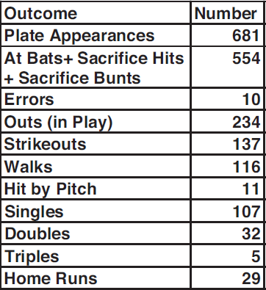
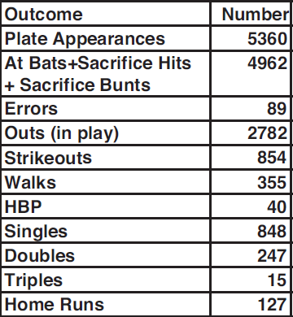
Monte Carlo Simulation
Added Value of Mike Trout To LA Angels
Trout Alone
Without Trout
2016 Angels: 717 Runs
Sim: 626 Runs

Slide 11
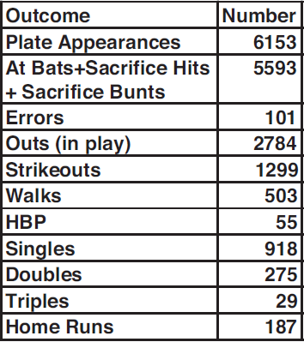
Monte Carlo Simulation
Added Value of Mike Trout To Average Team
Average Team
Trout
How Would We Simulate Average Team + Trout?

Slide 12


Pitching Evaluation and Forecast
ER = Earned Run
IP = Innings
Hypothetical Pitcher Ricky Vaughn
Situation 1
Ricky Lets 2 Batters on Base
Next Batter Gets Single and 1 Batter Scores
Ricky is Charged with 1 Earned Run
Situation 2
Ricky Lets 2 Batters on Base
Next Batter Hits Ball to Outfielder Who Drops the Ball
This Unearned Run is Not Charged to Ricky
Recall: ERA = Earned Run Average
Ricky Gives Up 22 Earned Runs in 72 innings
$$ERA=9×\frac{ER}{IP}$$
$$ERA=9×\frac{22}{72}=2.75$$

Slide 13
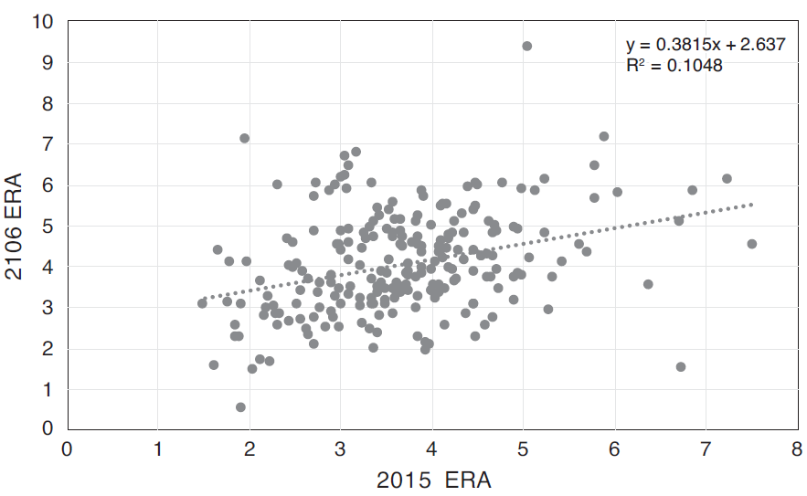
Pitching Evaluation and Forecast
ER = Earned Run
IP = Innings
Problems with ERA
Influenced by Errors (Subjective)
Influenced by Relief Pitcher
Influenced by Fielding Performance
Different Pitchers Evaluated Differently
Starting Pitchers = Wins
Relief Pitchers = Saves
Past ERA to Predict Future ERA
Why Predict Future ERA?
Weak Relationship
Results Based on All Pitchers Who
Pitched both Seasons

Slide 14

Pitching Evaluation and Forecast
y = Current ERA
y = Forecast ERA
K = Strikeout
BB = Walk
HBP = Hit by Pitch
HR = Home Run
Evaluating Forecast Error
Mean Absolute Deviation (MAD)
From ERA Model, MAD = 0.93
Additional Measures of Pitcher Effectiveness
Analysis by Voros McCracken (2001)
Fraction of Batters Faced by Pitchers That Result in Balls in Play
Fraction of Balls in Play That Result in Hits
Fraction of Batters Faced by Pitchers That Do Not Result in Balls in Play
Defense Independent Pitching Stats (DIPS)
K, BB, HBP, and HR
Independent of Teams Fielding Ability
$$MAD=\frac{1}{n}×\sum_{i=1}^{n}{|y_{i}−\hat{y_{i}}|}$$
Difficult to
Predict

Slide 15
Pitching Evaluation and Forecast
K = Strikeout
BB = Walk
HBP = Hit by Pitch
HR = Home Run
IP = Inning Pitched
t = Time (Years)
Defense-Independent Component ERA
Formula
C is usually around 3.1
Only DIPS Involved in Formula for DICE
Forecast Model
Correlation is 0.37 Compared to 0.34 when Last Year’s ERA is Used
MAD is 0.64 Compared to 0.93 when Last Year’s ERA is Used
Conclusion: Previous DICE is a Better Predictor of ERA than Previous ERA
$$DICE=C+\frac{13×HR+3\left(BB+HBP\right)−2K}{IP}$$
$$ERA_{t}=2.44+0.44×DICE_{t−1}$$

Slide 16
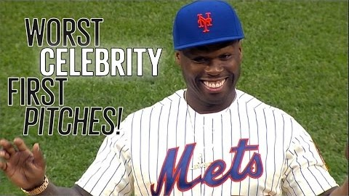
America’s Greatest Pastime

Slide 17

Final Inspiration
Politicians are like batters.
The best do their job 1/3 of the time.
-Mahatma Mario

